Slide 1

Maine Woods Forever Roundtable March 5, 2021
Maine’s Forests Through an Energy Lens: Lessons from History
Lloyd C. Irland
The Irland Group

Slide 2
Outline
18th century -wood wind and water
19th century -- steam and stream, wind and animal power
Transition 1890 to 1920 -- to electricity and oil/coal
1920-2015
  Electricity grows, then peaks
  Fossil fuels the same
2015 to date “Traditional” energy system disrupted
Future - Age of Carbon

Slide 3
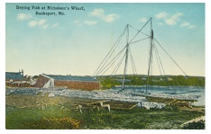
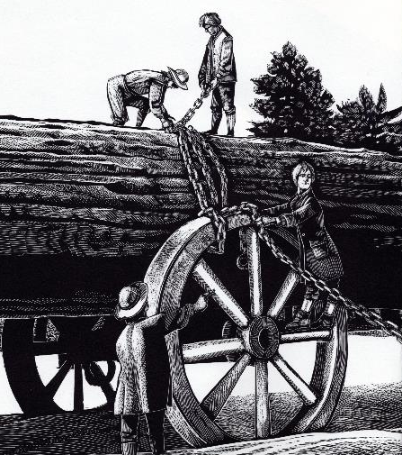
Maine’s Bargain with Nature:
You can have all the wood and fish you want,
but no hardrock minerals, and no fossil fuels!
Oh, and cold winters and short growing season….
McCurdy illustration from Applebaum Giants in the Land, 1993
Notes:
But, great hunting and fishing, wonderful scenery….
Until modern tourism, no way to make these virtues pay the bills…

Slide 4

18th century
Energy self sufficient
  Animal and human labor
  Wind
  Fuel: wood
Subsidized by old growth harvesting, fishing virtually virgin resources
Energy a huge cost to economy in labor input
Notes:
Firewood a necessity
Methods changes little since Middle Ages….
Men provided it in their wills for widows
Teachers ministers partly paid in fuelwood
The Public Lot for the first settled minister
Exports to Boston started early

Slide 5
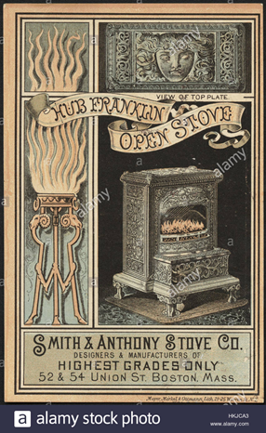
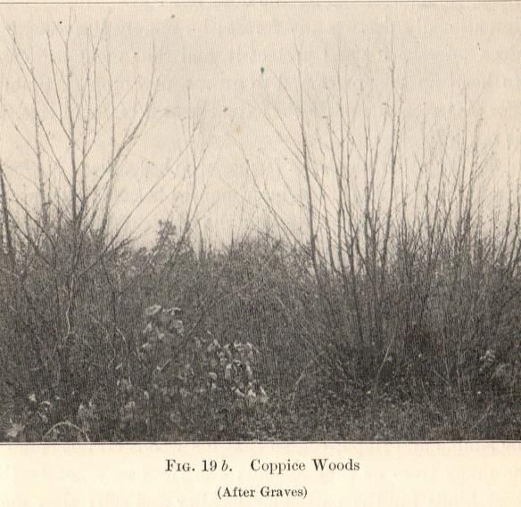
Within range of settlements, cutting reduced average age of the forest
Notes:
Open fireplaces Very inefficient
Later stoves less so
Houses drafty and inefficient; costly to tighten up
Maine has one of oldest housing stocks in nation
Winters: ice on the water bucket
No running water much less hot water…

Slide 6
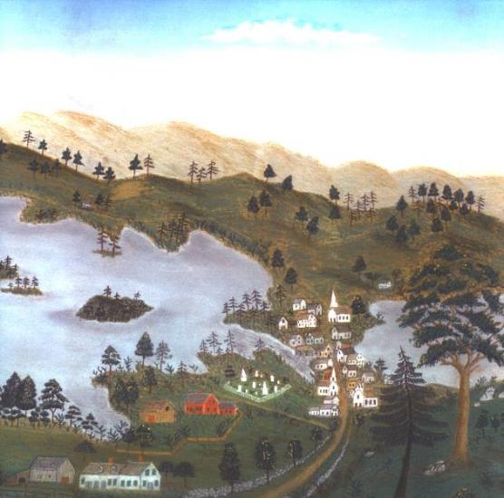
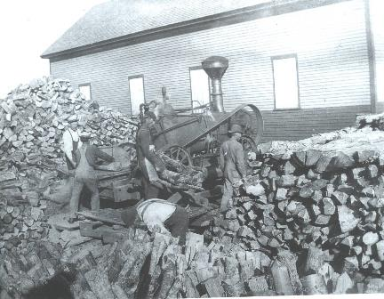
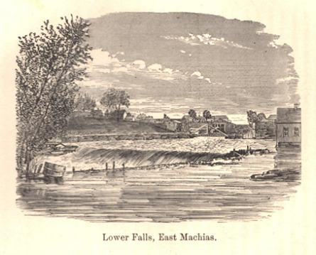
19th Century: Age of Steam begins as an Age of Wood Fuel
Heavy reliance on wood fuel till end of century
Notes:
Steam brought us the railroads
been gone so long we’ve forgotten their impact
Connected E Maine and Aroostook to the world
Steam power freed sawmills from riverbanks and dams
They could go anywhere and
Get larger
Not so the paper mills…. They got huge
And still needed heat – coal or oil, later biomass

Slide 7
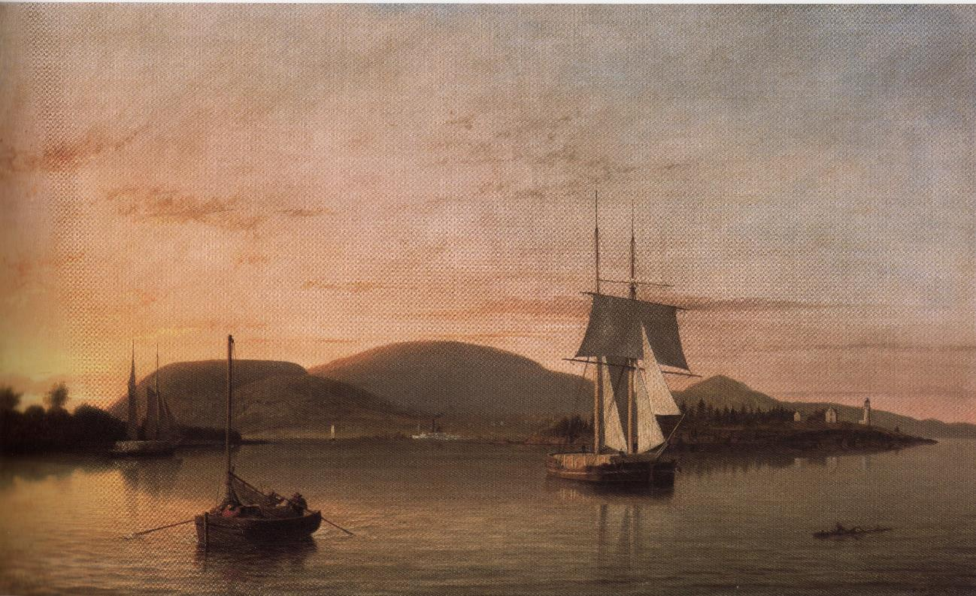
Fitz Hugh Lane, Camden Mountains from south end of the harbor, 1859
Notes:
Lumber schooner
Wood from some small mill at mouth of almost any small stream, or the Penobscot.
Schooners were mostly “coasters”, bound for southern New England or New York.
Deckloads, green lumber, no drying

Slide 8
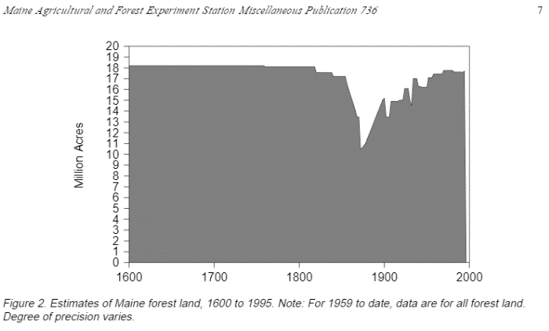
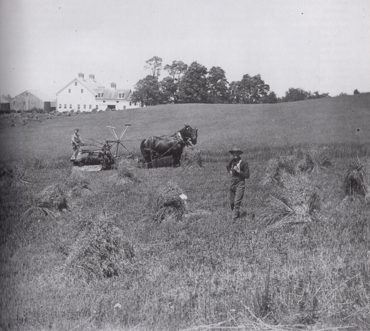
Internal Combustion engines returned 4 million acres of Maine to Forest
All of this land was cleared without benefit of internal combustion engines
WH Bunting, A Day’s Work, part 1, p. 173
Notes:
Hayburners to Gas burners
Hayland no longer needed
More seriously, tractors and later machinery enabled large efficient farms on deep midwest prairie soils
Drove grain prices down and reduced competitive position of Maine farmers.

Slide 9
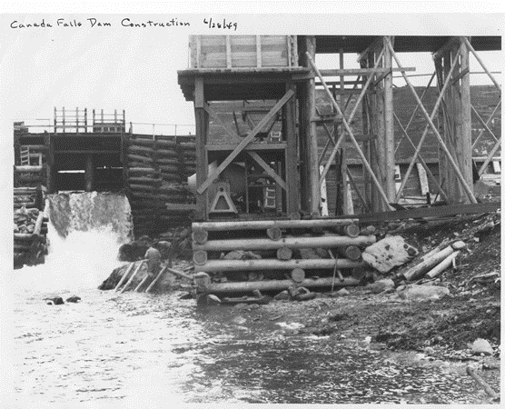
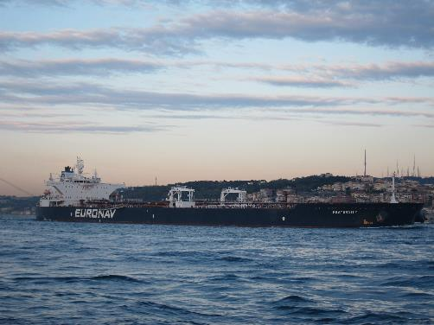
1890s to 1930s Age of Electricity
Horsepower or spindles to Megawatts
Powerlines -- key tech leap
  Enabled Bucksport to be built with no nearby hydro!
Supertankers replace woodlot: bring the fuel to us
Outsourced our fuel
Notes:
Throughout 19th c, hydro was direct drive power
horsepower CURRENT War film
Late 19th C, electricity arrives for Lighting!
By 1930’s in Maine most electric was hydro; many small municipal utilities
Farm electrif. was 35% in Maine in ‘34, vs 60% in NH
Half its potential was developed
High tension powerlines broke link between generation and end uses of power
Tankers outsourced our fuel to other regions/continents

Slide 10
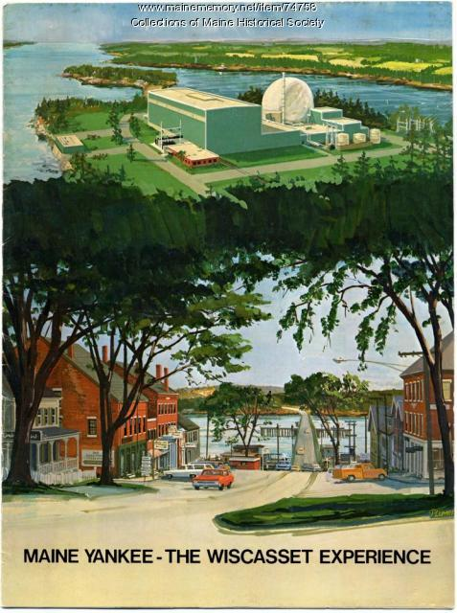

Maine’s brief nuclear age
1972-1996
Notes:
Transition that never happened:
power too cheap to meter
Ambushed by fracking >>> Cheap natural gas
Maine Yankee, Pilgrim didn’t wear out, outcompeted by natural, gas.

Slide 11
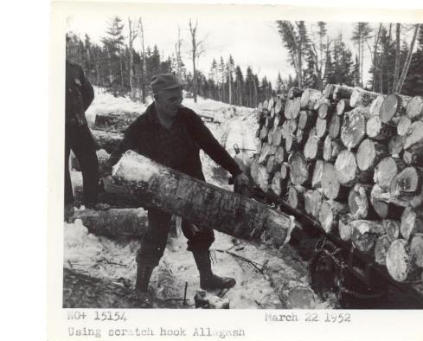

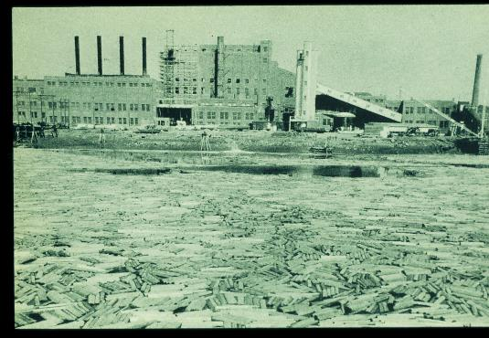
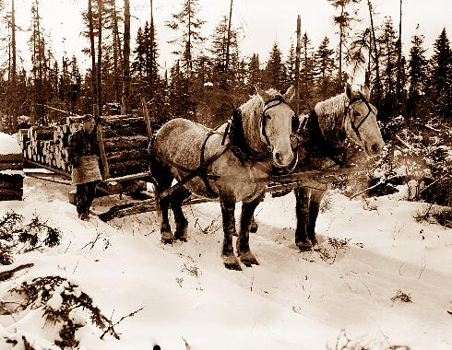
20th Century –the 19th lingers on a Long Time
Early 50s
Mid 30s
“The Northern” Used horses till early 60s
Notes:
Painting in Upper Left – M. Zorach 1930s looing back but had farming changed that much? N.
Handloading pulp till 50’s, horses till 60’s
Papermill shown on of few not next to its dams – built to find a use for Wyman Dam power. Kind of backwards?

Slide 12

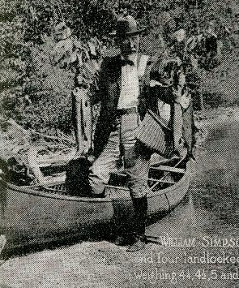

20th: Gas & Oil Guzzlers Galore
Auto ownership
Houses larger but no more efficient per sq ft.
Sprawl – least efficient energy system that could be devised!
Outdoor recreation goes motorized
Tourist dollars from Away….
Industry shifts to Electric (or leaves)
Notes:
Sprawl didn’t just happen:
Immense public investments to build and expand highways, sewers enabling sprawl
Cheaper energy enabled it all

Slide 13
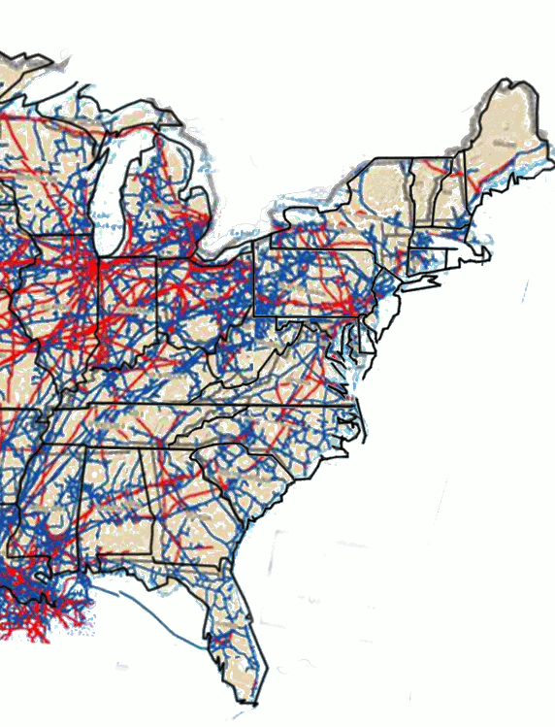
Self sufficiency
Oil and Gas Pipelines
Businesses/homes networked: phone, sewerage, electric, and gas heat (Gordon)
Regions too.
With pipelines, tankers, and powerlines we ignored self-sufficiency
Resilience was assumed
PHMSA.dot.gov
Notes:
19th century no option
20th century forgotten
Maine outsourced much of its primary energy needs to other states and continents and enjoyed the low costs.
Created a culture of consumption ands believing that pollution and inconveniences of producing energy were for somebody else…. Maine is to pure
21st Self suff. Will be a byproduct of new system

Slide 14
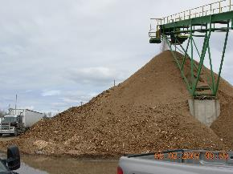
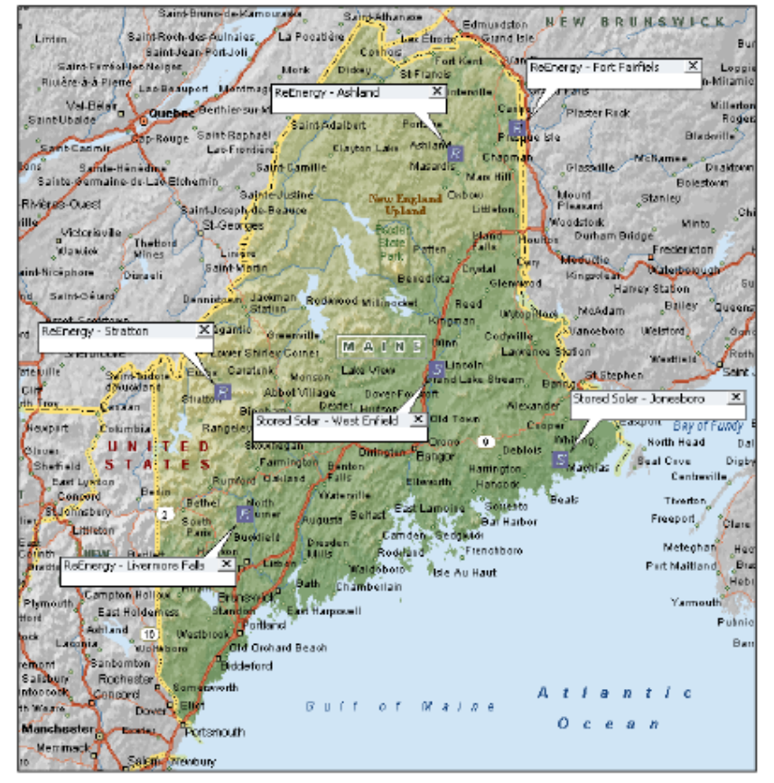
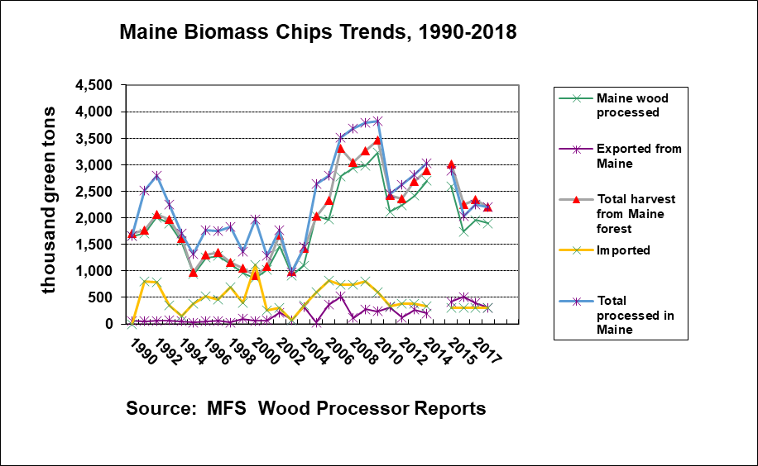
Saudi Arabia of the North?
Once there were about a dozen; and big cogens to boot.
INRS report to GOER, 2017. p. 8.

Slide 15
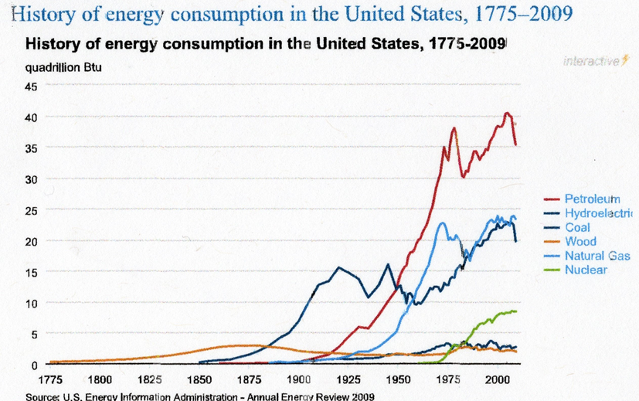
Wish I had one of these for MAINE!
NOTE HOW LONG THE TRANSITIONS TAKE –
DISPLACING THE BIG 3 A COLOSSAL TASK!
Notes:
This is for US – wish I had the data to do this for Maine.
Can see the dominance of oil;
The plateauing if gas, that of nuclear not so clear by 2009
Wood & hydro footnotes…
Comp. to 19th c, people spend little of income and no labor time on heating, cooking, and transportation energy

Slide 16
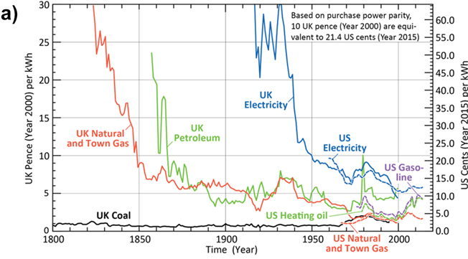
Stunning Real Cost Declines
The electrification of energy: Long-term trends and opportunities
Jeffrey Y. Tsao, et al.
MRS Energy & Sustainability , Volume 5 , 2018 , E7
DOI: https://doi.org/10.1557/mre.2018.6[Opens in a new window]
Notes:
Points: Huge declines in real prices
This chart a short course in energy economics!
Enabled massive and inefficient uses at lower and lower costs….
In housing. Offices, transportation, and industry.
Massive sprawl into the forests
Shadow conversion

Slide 17
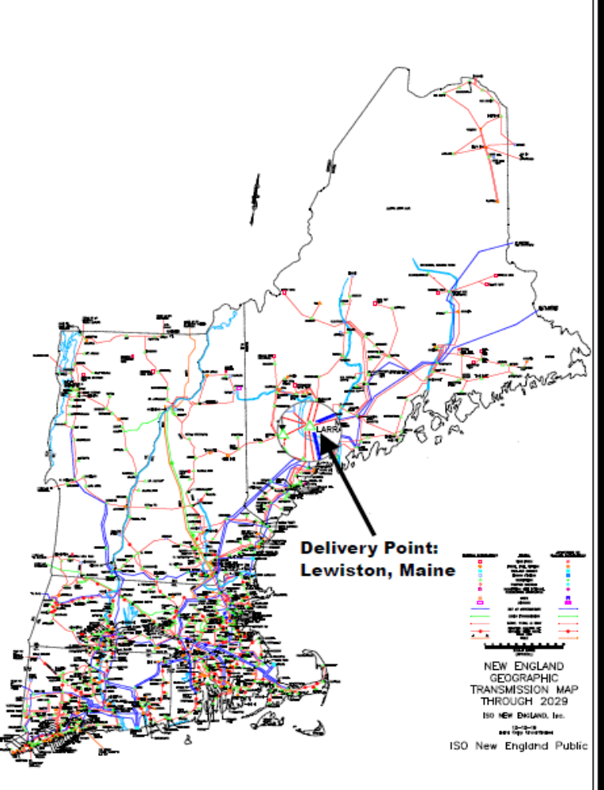
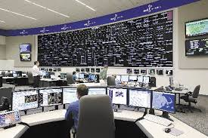
21st Century
Age of the Grid
Power users not tied to generating stations anymore
Market for “Green” Power
Notes:
Not only dispatching power but pricing it.
Power pool existed before but between utilities that also controlled generation
Goal: drive out high cost sources.
Ignore issues of Fuel mix and environment

Slide 18
The Future
Up to the 60s increased power supply viewed as desirable – a public benefit
In future, rapid development of electric power again advocated as a shared social goal – halt global warming
Disclosure: my record as a forecaster is not very good
Notes:
After 60s,
Abundant cheap reliable power taken for granted
We were pushing developments with bigger negatives
Like Dickey Lincoln.
It then became “private greed vs the environment”

Slide 19
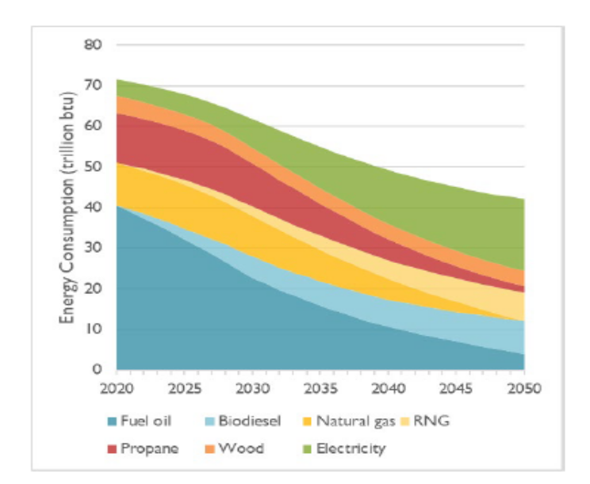
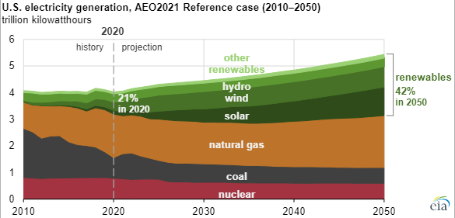
Age of Carbon: Two Views of the Future
US Energy Information Administration
Maine total space heating from Synapse report for GCC
Notes:
Left a conventional recent BAU case based on relative costs and demand projections -- no change
And no consumer has to do anything differently (carpooling?)
On Right, space heating energy sources --
Much more efficient electrified system
Huge barriers in existing building stock, costs, owner incentives
If achieved, does it threaten even more sprawl???

Slide 20
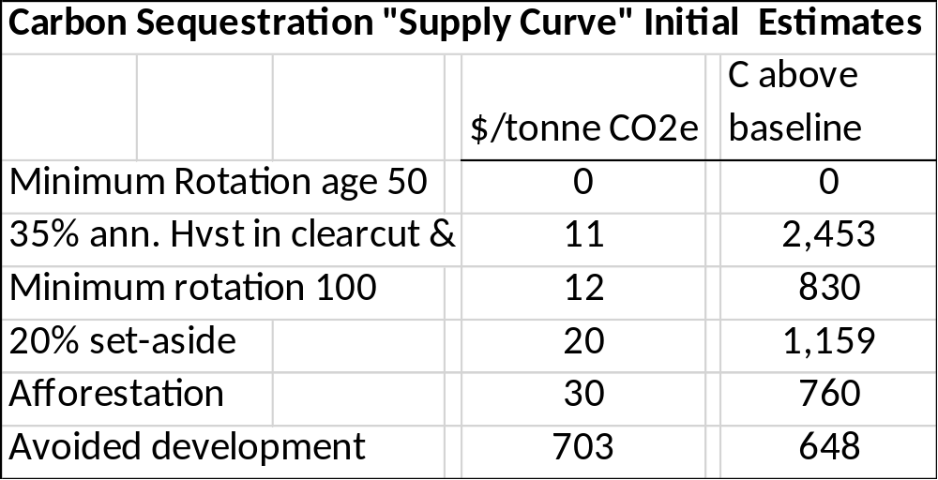
Forest Management As Carbon Storage
Notes:
This is a cost curve from research by Adam Daigneault and colleagues at UMO
Consider it “stylized facts” –first cut estimates
Within each category are also cost curves
Remember Slide 1 above? There will be cheaper places to do all of this!!!!
So how will affect Maine highly uncertain

Slide 21
Themes
The “Ages” Overlap and often live side by side
Past transitions took 50-75 years to complete
Replacement technologies were:
  in abundant domestic supply
  Technologically dynamic
Losers could be ignored
Notes:
Replacements –
New primary fuels abundant in US!
New science/engineering – sourced largely in US
Strong value to customers
Huge scale economies
Network externalities
Times of economic flexibility and rapid growth
Geographic relocations – building Cal, Fla overnight

Slide 22
Observations
Previous transitions: They had Time
  Looks like we don’t
  Carter: Energy Independence
    Moral Equivalent of War (MEOW)
    They were decentralized, incremental, huge only in retrospect. No central plans, no planning by Washington , Regional Grids, state governments
    Since no one HQ, no place where resistance could focus.
Obama: Carbon as Pollutant
  Coal state Senators: “War on Coal”
Maine Energy self-sufficiency
  Fluctuated from age to age:
    Autarchy in 18th century
    Shifted toward coal/oil in 19th
    Dramatically import dependent in 20th c.
    Renewables: move back to self sufficiency by necessity

Slide 23
Observations
In the past, huge capital investments could be funded anticipating growth & rising incomes
  Beneficiaries got benefits on the installment plan, no money down, and cheaply
Now: to electrify – must produce 2X to 3X to stay where we are
Enthusiasm for Forest Carbon storage varies
  We like wilderness Areas!
  We like high yield plantations!
  We’d like to get paid for Carbon credits!
  These mirror existing divisions…
Notes:
Carbon forestry
Worthwhile but a small part of the ultimate transition
Again, cheaper sources of these benefits elsewhere
Many want Big Action on CO2, but in forestry must be business as usual..
Realistic? More likely to prevent progress.

Slide 24
Conclusions
This Transition Needs to be Double Time!
Government aids & $$$$ necessary
Social, political, and equity obstacles critical
Can society adapt to paying the social cost of its energy?
Meaning for forest unclear
  Biofuels? I doubt it
  Carbon forestry? Time will tell
    Not as cheap as some think
Remember: cheap energy enables sprawl and wasteful, energy use.

Slide 25



What forest will these fellows see?
Thanks for your time and interest. LCI

