Slide 1
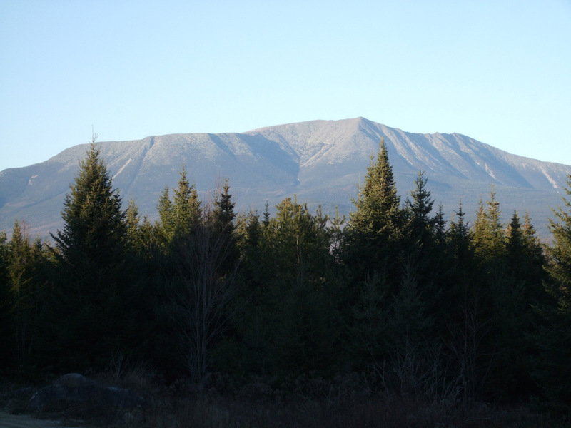

Twenty one Percent of Maine’s Land in Conservation - How we got Here… and How about Water? .
Lloyd C. Irland
The Irland Group and
Univ. of Maine, SFR (associate)

Slide 2
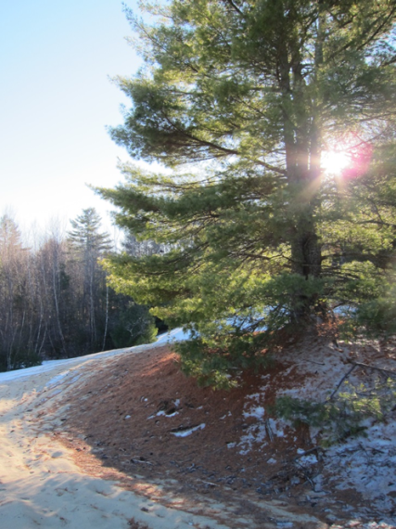
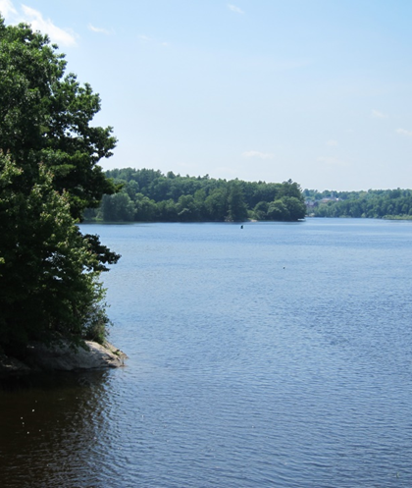
Contents
History – from 1603
History changes direction post 1972
Current Status
Lakes and rivers
Unexpected Reactions
What this says about Maine:
  Why 100 mi on Allagash – how much on Lower Kennebec?

Slide 3
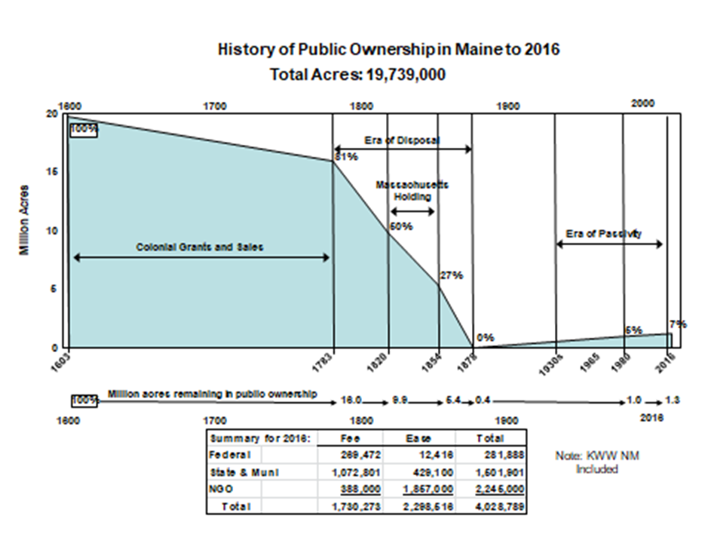

Slide 4
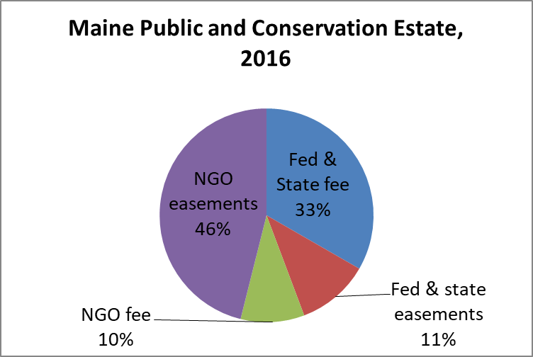
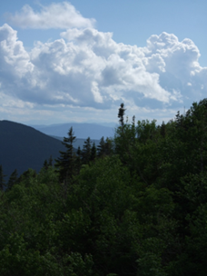
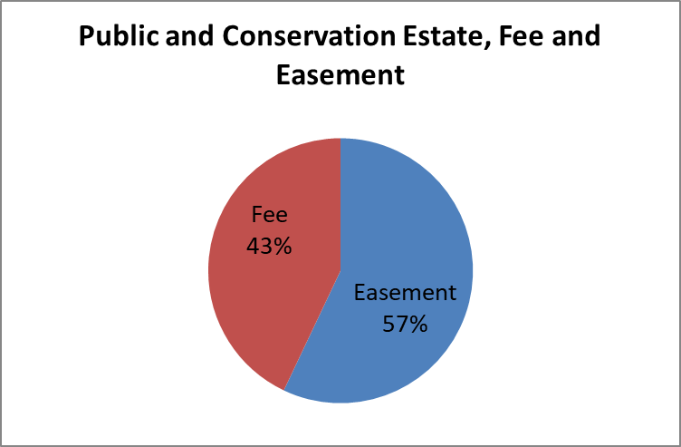
Total Conservation and public estate 4,028,789 acres
7% Federal
37% State and Muni
56% NGO

Slide 5
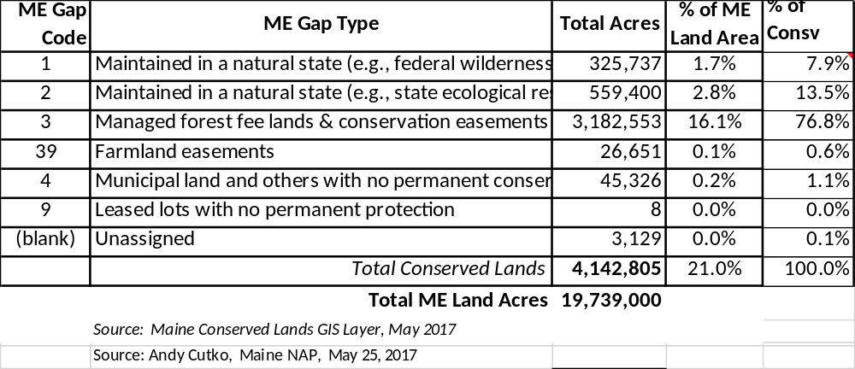

Slide 6
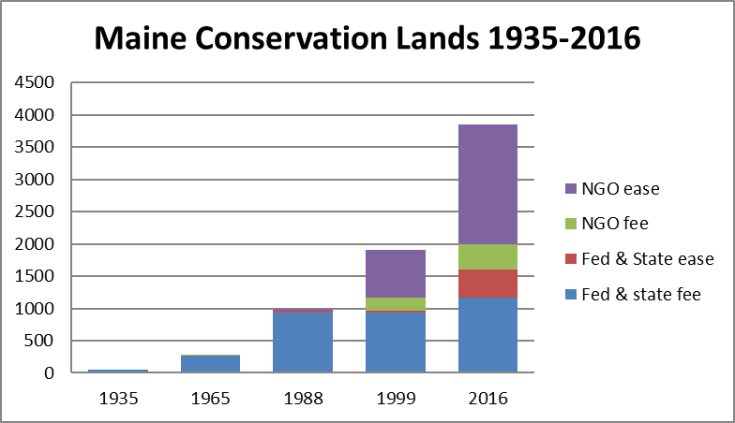

Slide 7
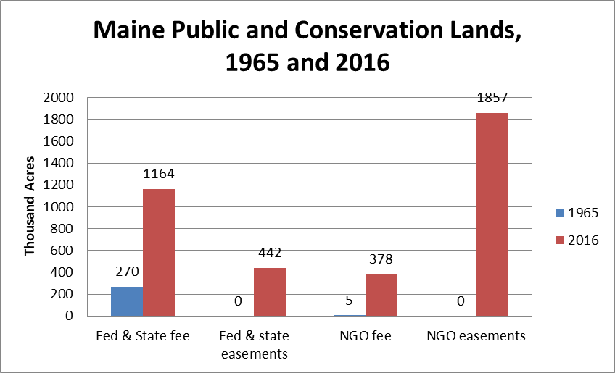
Era of Acquisition -- Principal Actors

Slide 8
LMFB a Critical Funder, Sparkplug
Cumulative to 2016:
        1,000s
Total Acres 591
  Fee 275
  Ease 316
Breakout: Percent
  Piscataquis 46%
  Washington 14
  Somerset 12
  So Maine
    8 counties 7
LMFB Founded 1987
State Bond funding
Program design attracted local/NGO Interest
Match and coordinating sparked many projects
Bipartisan support
Federal earmarks
NGO $$$, Skills

Slide 9
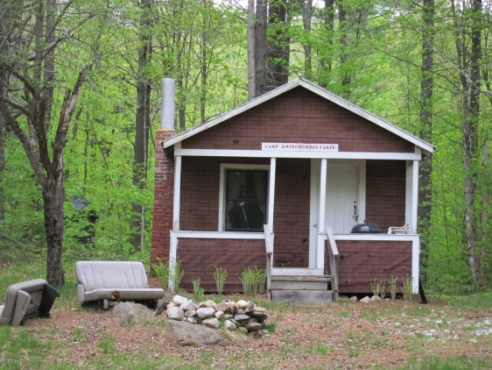
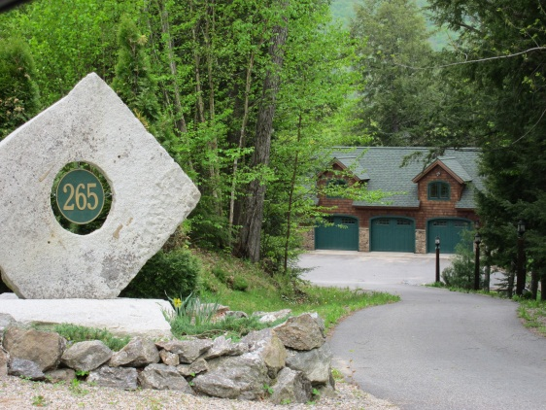
WHY EASEMENTS?
Maine leisure residence, 1940s (nr Newry)
What the 1% Wants Today (These are almost neighbors)

Slide 10

Irland’s law of real estate markets:
“Nice places attract capital until they are no longer nice”

Slide 11
How Much is Enough?
What Conservation/Recreation/ Land use needs remain unaddressed?
Is 79% of the State enough for future development?
Many states with more Public Land than Maine have state policy goals to obtain more!
How to measure for water?

Slide 12
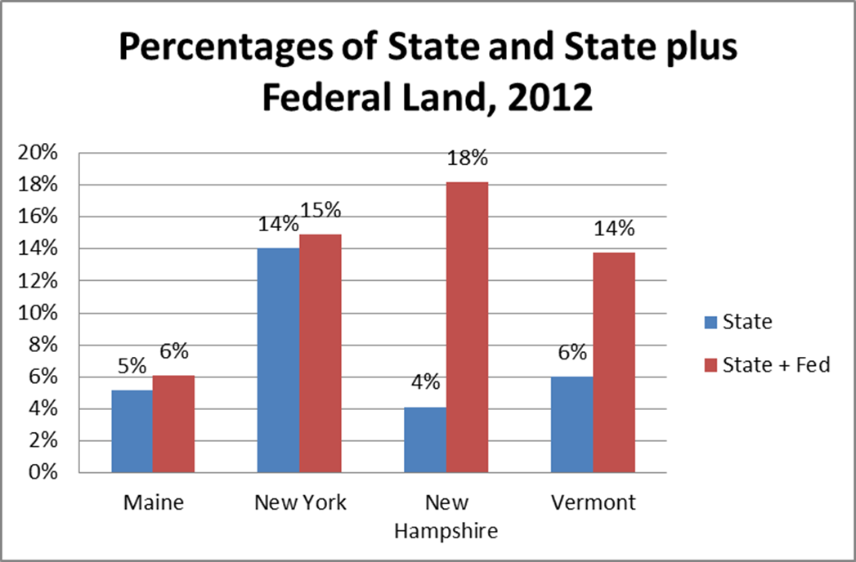

Notes:
This is fee land.
Maine & NY: rely on State, little Federal.
VT, NH, National Forests.
Maine’s Era of Acquis. more than a century behind the others!

Slide 13
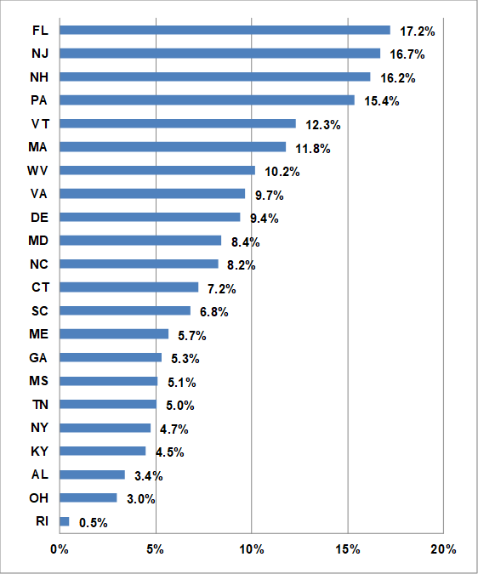
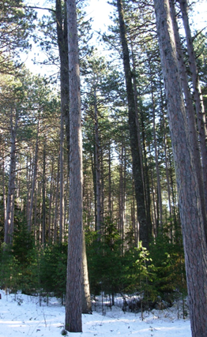
Percent of land in Federal and State Fee and Easements, 2016

Slide 14
What’s this Mean?
Today:
  Reserves (Andy C) 4.5%
  Brundtland Goal (Reserves) 12%
  CBD pct by ecosystem 17%
  Protected against Development 19%
  NEGC goal 2009, forests, 50%
  W & W (2017) Goal working forests 70%
    Wildlands: 10% of the forest
  Minimum for biodiversity? D.k.
  What would apply for water?

Slide 15
Conservation Lands by Regions
Classified by percentage of total county land in conservation. State Ave = 19%
Above 19% % of Total
  Pisc, Som, Wash, Oxford 2.7 MM A 68%
10% to 17%
  Han, AR, Frank, Sag, York .99 MM A 25%
7 to 8%
  Knox, Pen, Cumb .21 MM A 5%
3 or 4%
  Linc, Waldo, Kenn, Andro .7 MM A. 2%

Slide 16
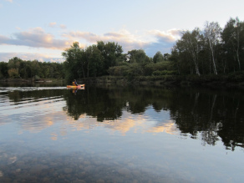
How about the Waters?
Pollution cleanup focused on regulation, and downstream of factories, cities
Fish -- manage by controlling harvest, not habitat (till ’72 CWA)
“Saving rivers” by stopping dams… ad hoc and responsive, not proactive
Rivers Legislation 1983 – a compromise
Public Lands Trades
  Focused on large tracts, important lakes
  Avoided corridors, as Allagash
Allagash, but not the Downeast salmon streams

Slide 17
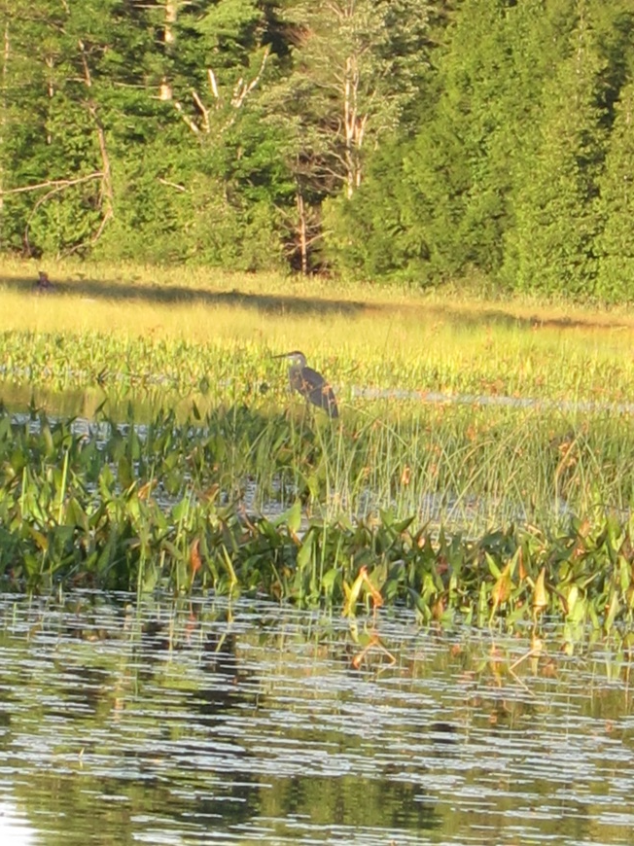
Wetlands
Leave it to the feds
  International migratory birds
  IF&W Game areas (much w fed funds)
Great Heath – nobody wanted it!
Handle by regulation – post 70’s

Slide 18
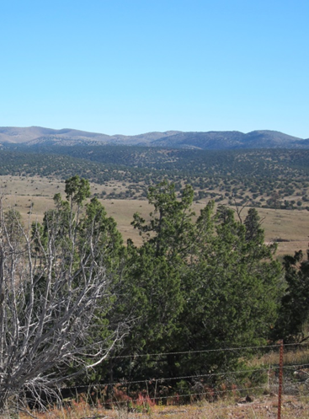
Reaction against the era of Acquisition
Political allergy to federal involvement
  Citizens; local governments
  Local version of Sagebrush Rebellion
“Tea Party” Movements
  Resentments over regulation, LURC CLUP
  Post 2006 Crash – frustration over weak economy; lashing out against “causes”
  Bipartisanship in a coma; parties themselves divided; demagogues rewarded
  Conservation land acquisition a symbolic target with a big bullseye on it for large range of grievances
Conservation groups blindsided
  Me too (smug?)
An Eastern Sagebrush Rebellion?

Slide 19
Water Politics in Southern Maine
Most past debates over dams were in wildlands: Dickey-Lincoln, Passamaquoddy, Big A, Others
Current disputes over dam removals, fish passage, intensely local.
Waterfront residents resist restoration: Mousam R.; Sheepscot Lk; Outlet Stream, many more
Standard NGO campaigning methods don’t work here.

Slide 20
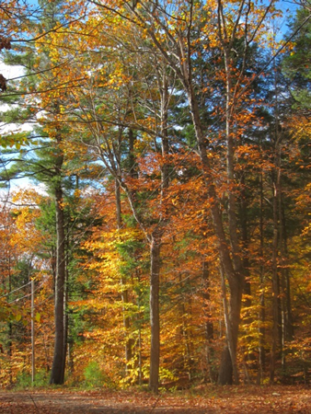
But for rounding out units and a few loose ends, N. Maine is arguably in good shape.
Up there we want more Easements.
The big Agenda is in Southern & Coastal Maine for virtually all forest values.
For the Waters?
Proposed Wayne Town Forest

Slide 21
Things Ownership Can’t fix by Itself
Atmospheric inputs, e.g. mercury
Past damages, bulldozing, tributary dams
Past shoreline development
Bark and sediment deposits, toxics
Exotics
  With water it’s harder!

Slide 22
Key Points: Maine’s History
Usually (always?) Reactive – wait until the bulldozer arrives
Private Initiative and Private wealth Critical in Many important cases
Maine came WAY late to acquisition mode
  Thereby maximizing the financial cost and political strains
  Maximizing lost opportunities
Maine loves conservation so long as it costs us little

Slide 23
Key points…
As to acquisition/easements, water an afterthought
  Then usually only for recreation or fishing
Acquisitions largely responsive & place based too many loose ends remain for both land & especially water

Slide 24
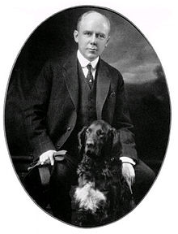
How to Move Ahead?
Past reliance on Feds
  Politically unpopular exc. as “Moneybags”
  LAWCON temporary hold late 2015
LMFB prolonged ordeal by Gubernatorial fiat
Dependence on private wealth -- more Governor Baxters?
Local, County funds?

Slide 25

Questions/Comments?
Thanks for your time and attention…
Tumbledown.

